Slide 1
Kururugi ESC – Visuals
Stepane Binon – 31/03/2026

Slide 2
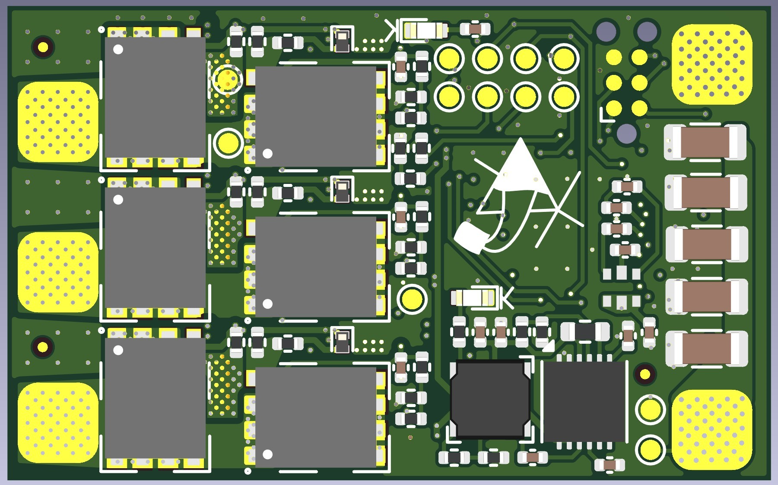
Power Stage: The 3 half bridges
VGATE LED
Probing zone
Battery conections
Vbat Filtering
BLDC conections
RGB Debug LED
3xVoltage and 1xtemp sensing
3V3 LED
Buck (VBAT -> VGATE)

Slide 3
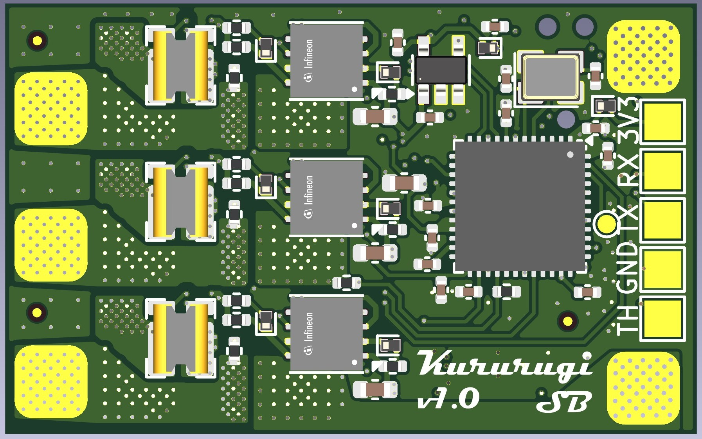
Gate driver: For MOSFET driving
Shunts: For current sensing
LDO: 5V stage
Crystal: 5V stage
Auxilary 3V3
UART
Throttle command:
PWM/DShot
VBAT sensing
MCU – STM32G484

Slide 4
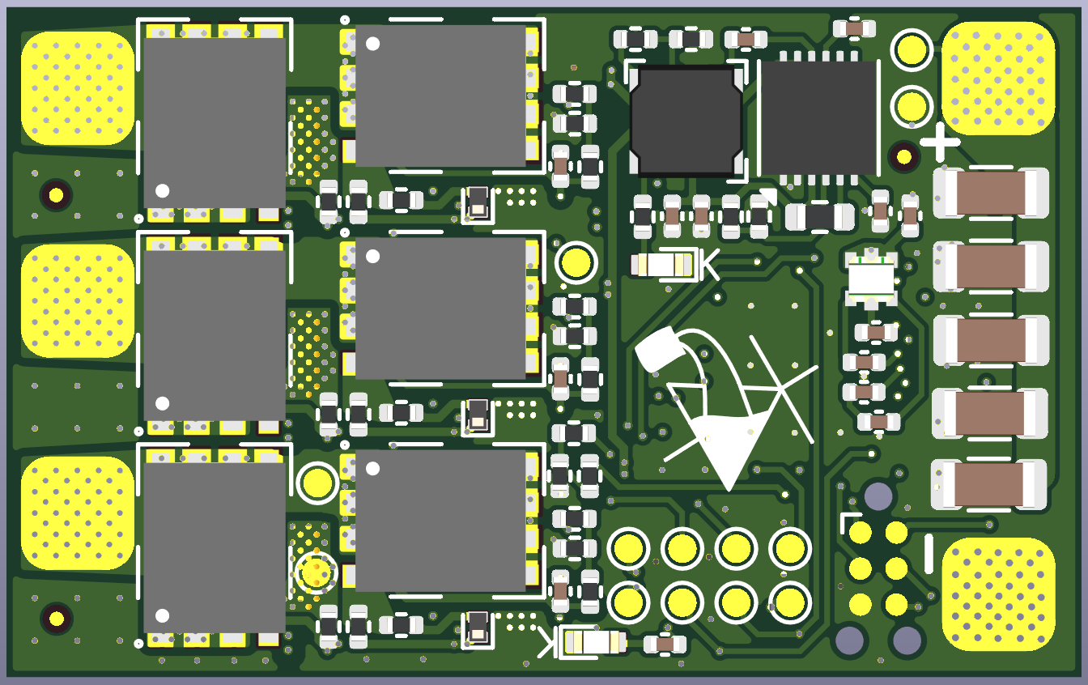
VSENSBAT testpoint
VBAT testpoint
VBAT PAD
2.2uF MLCC
GND PAD

